Slide 1





https://ogawalabteamsurface.dentistry.ucla.edu/
https://weintraubcenter.dentistry.ucla.edu/ogawa-lab-team-surface
https://weintraubcenter.dentistry.ucla.edu/takahiro-ogawa
https://dentistry.ucla.edu/profile/ogawa-takahiro
Takahiro Ogawa, DDS, PhD
UCLA TEAM SURFACE
Professor, UCLA School of Dentistry

Slide 2
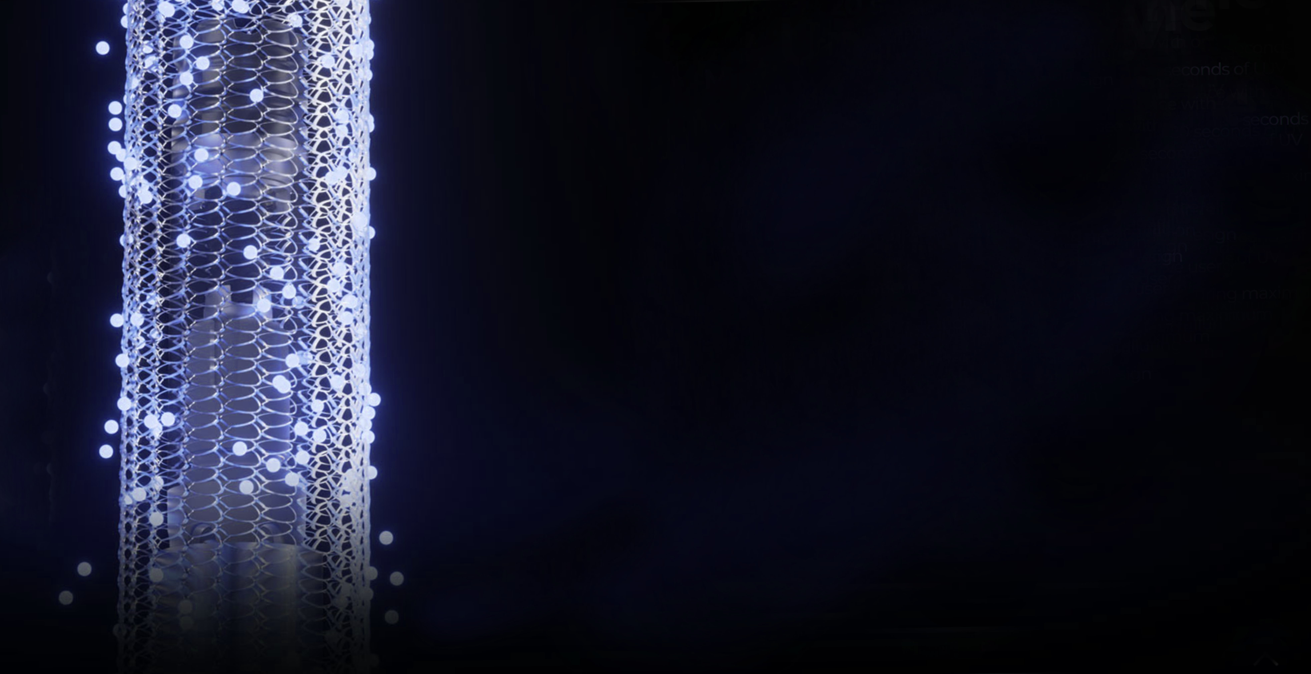


A new norm of implant science
Implant pellicle and VUV
^{.O}2⁻
_{Superoxide anion}
O₂
Takahiro Ogawa, DDS, PhD
Professor
Prosthodontics and Weintraub Center
UCLA School of Dentistry
e⁻
_{H2O}
_{Hydroxyl radical}
O₃
O₂
O(¹D)
^{h+}
^{.OH}
_{Singlet atomic oxygen}
The Next Gen Implant Dentistry with VUV
Tak Ogawa

Slide 3
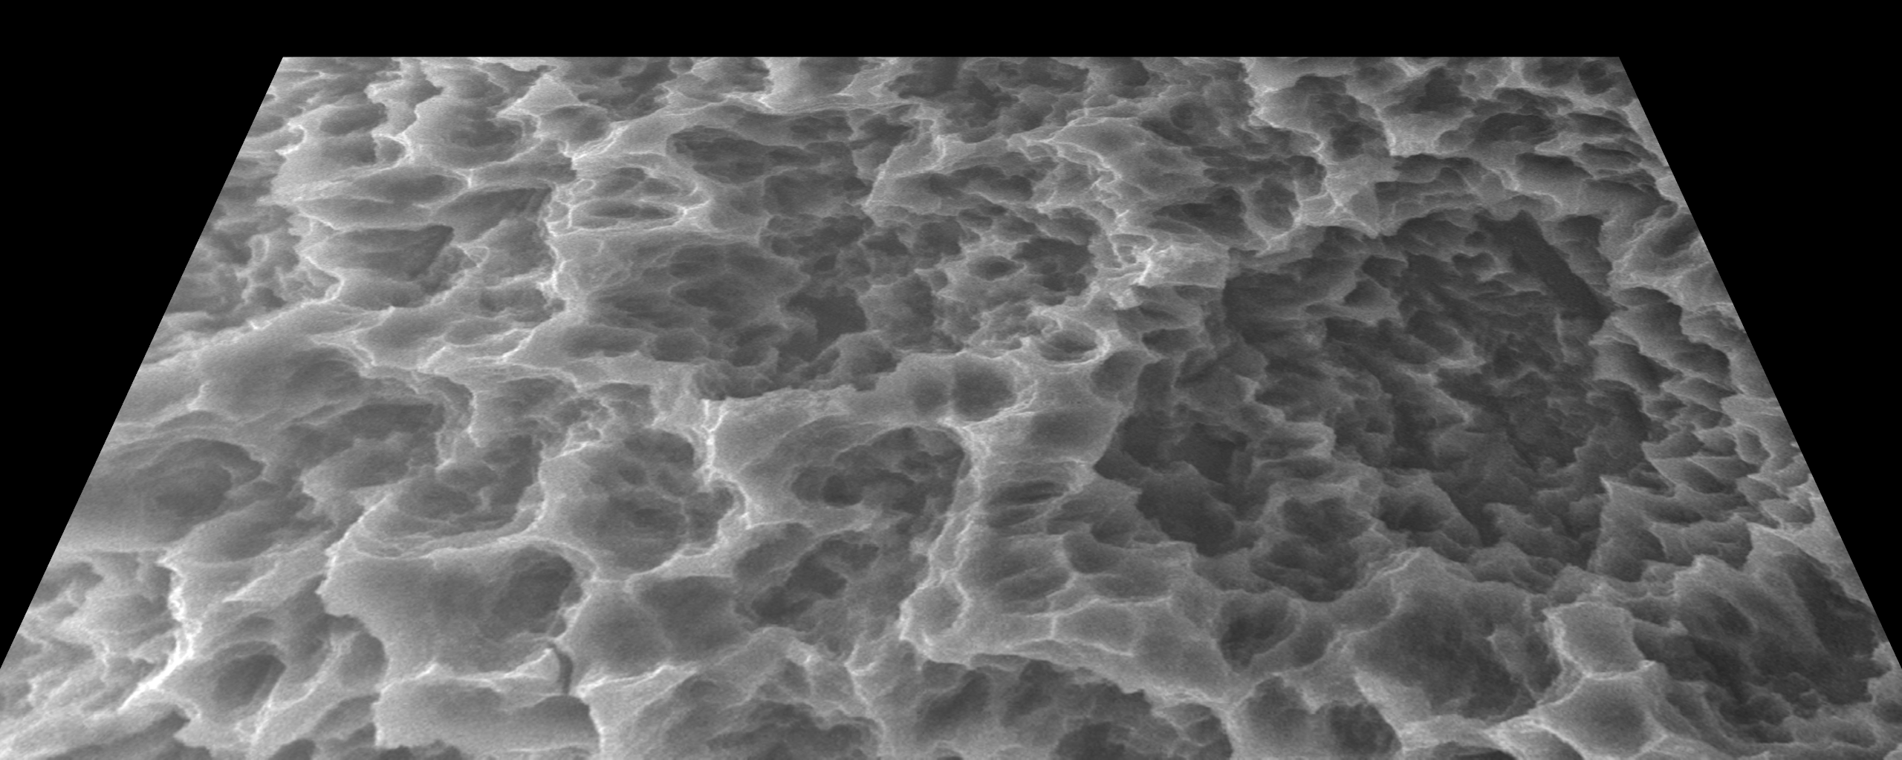
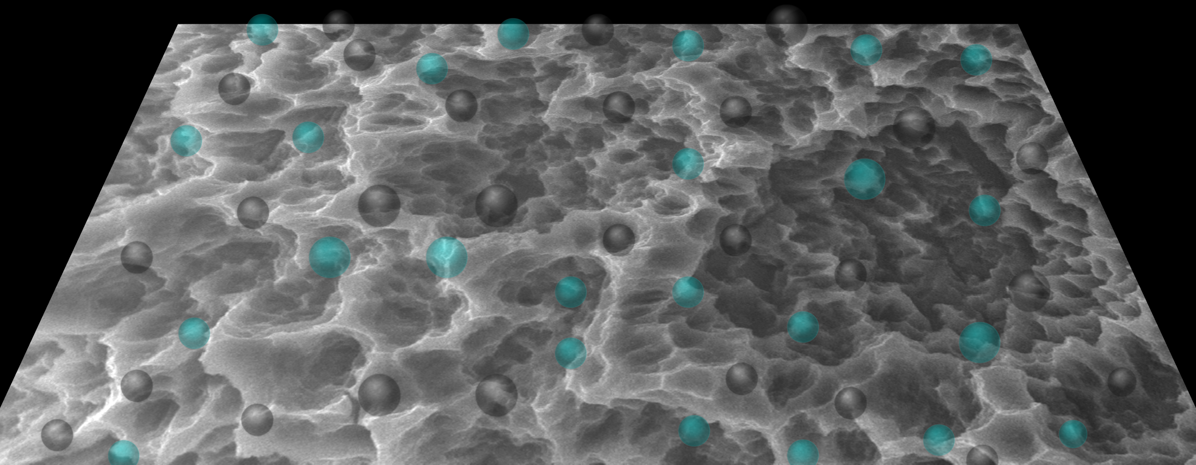
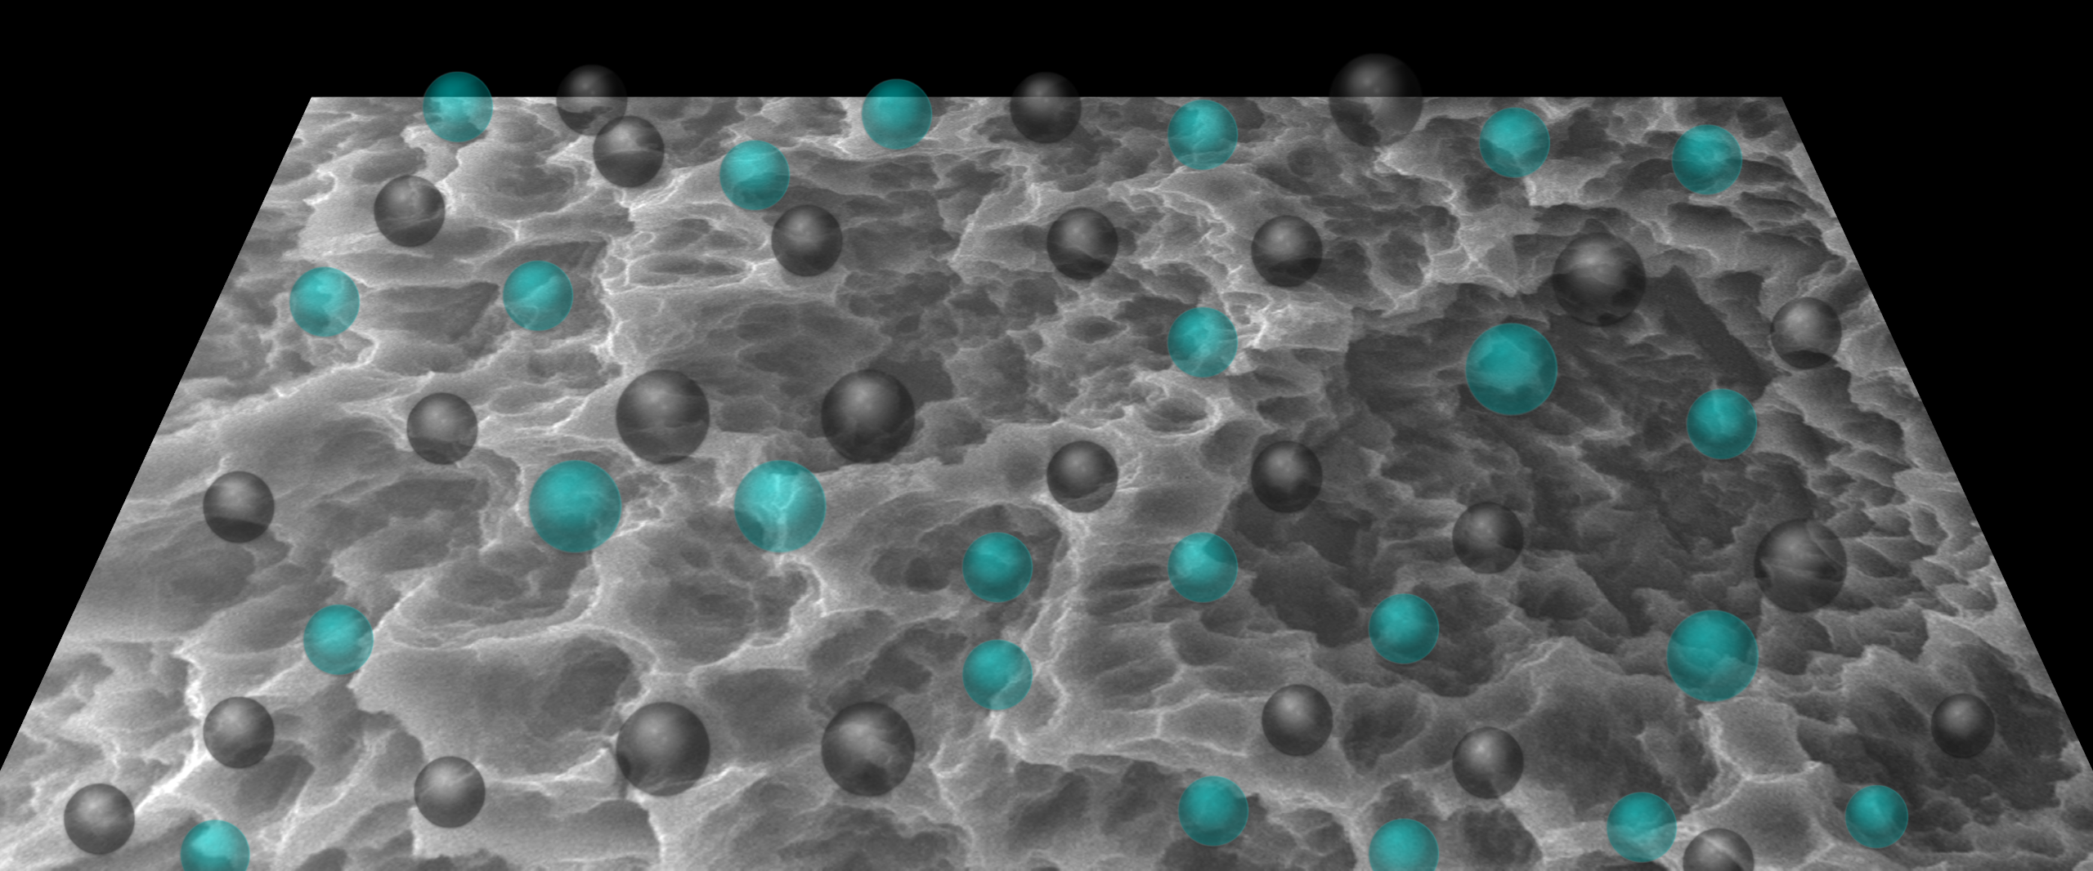
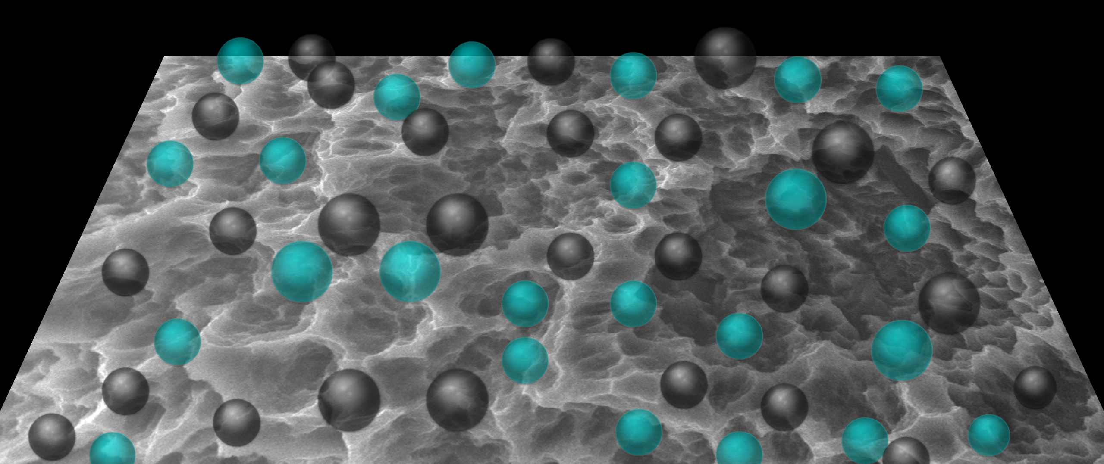
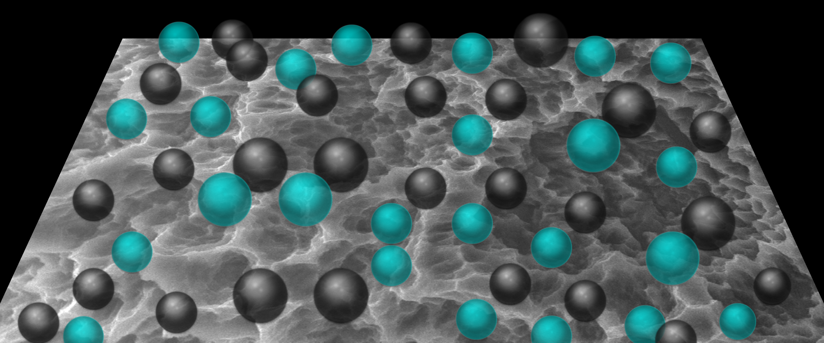
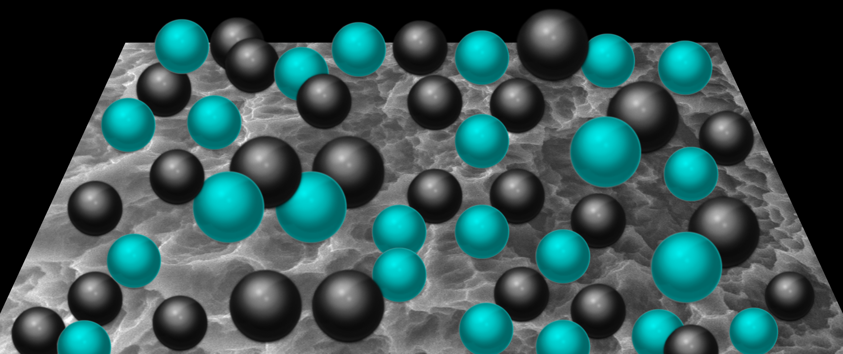
Titanium undergoes biological aging.
1. Time-dependent hydrocarbon deposition on its surface
New
3-day old
7-day old
2-week old
1-month old
Unknown age

Slide 4
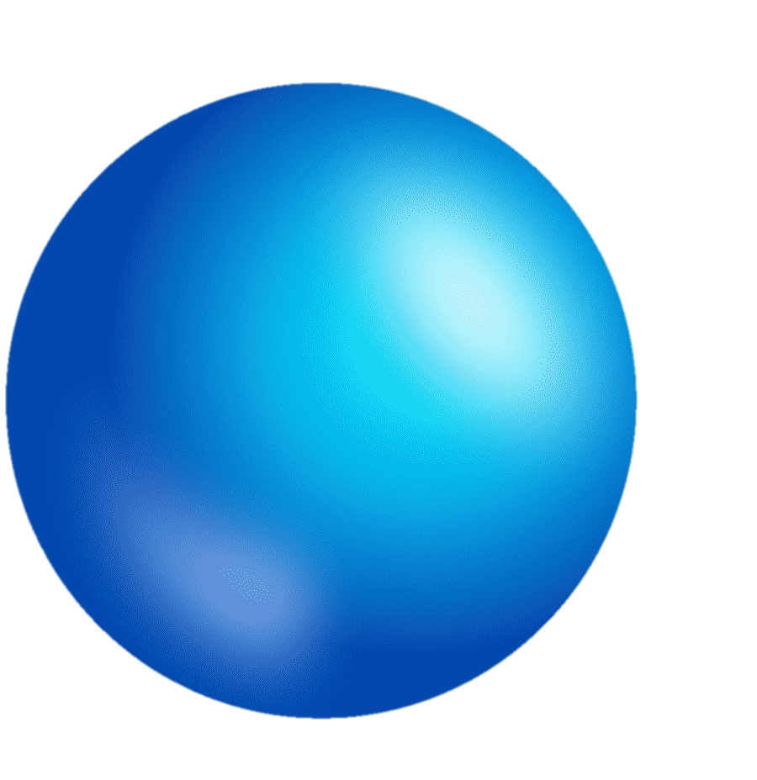
Titanium undergoes biological aging.
62
47
Surface carbonization (%)
22
14
Day 0
Day 3
Week 2
Week 4
Age of titanium

Slide 5
Titanium implant surfaces are no longer titanium.
The hydrocarbon layer is defined as
Implant
pellicle
The Next Gen Implant Dentistry with VUV
The Next Gen Implant Dentistry with VUV
Tak Ogawa

Slide 6
Implant pellicle vs dental pellicle
The dental pellicle is a protein film that forms on enamel, dentin, and crown surfaces by selective binding of glycoproteins from saliva.
Implant
pellicle
The glycoproteins in the pellicle prevents continuous deposition of salivary calcium phosphate and, instead, attracts bacteria and bacterial products.
The implant pellicle is a carbon film that forms on implant surfaces by naural binding of hydrocarbons from atmosphere.
The hydrocarbons in the pellicle prevents bone deposition and, instead, attracts bacteria and facilitates biofilm formation.

Slide 7
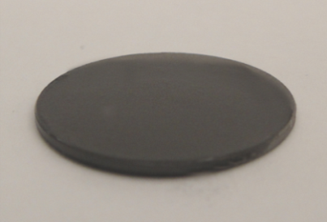
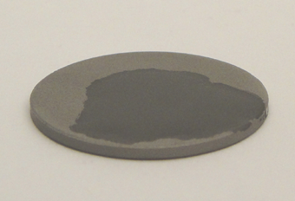
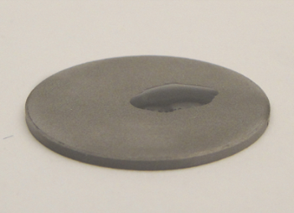
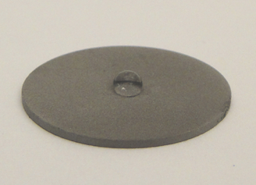
Titanium undergoes biological aging.
2. Time-dependent degradation of hydrophilicity
Hydrophilic
Hydrophobic
New
1-day old
1-week old
3-month old

Slide 8
Due to Ti aging,
Bone-implant contact is compromised by 60%.
Strength of osseointegration is compromised by 55%.
The number of osteogenic cells attached to implants is compromised by 65%.
New implant
The amount of proteins adsorbed to implants is compromised by 75%.
Dental implants are severely bio-compromised.
4-week old implant

Slide 9
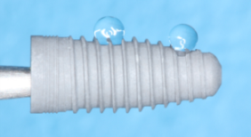
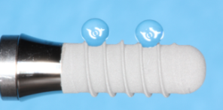
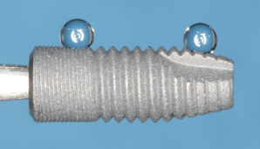
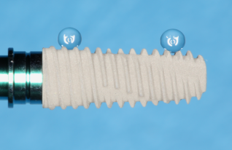
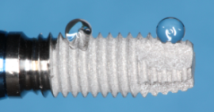
Titanium undergoes biological aging.
No exception

Slide 10
A simple, reasonable idea.
Bring back titanium surfaces as they are meant to be.
Pellicle-free implants

Slide 11
UV treatment restores bio-compromised titanium.
1. UV decarbonizes titanium surfaces and removes the implant pellicle.
62
47
Surface carbon (%)
22
14
14
Day 0
Day 3
Week 2
Week 4
UV
Age of titanium

Slide 12
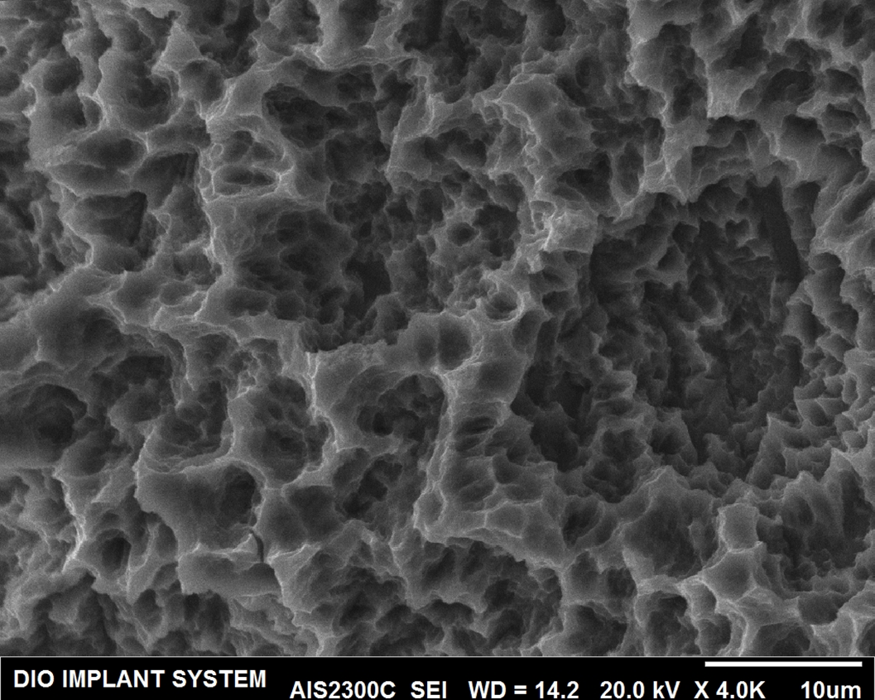
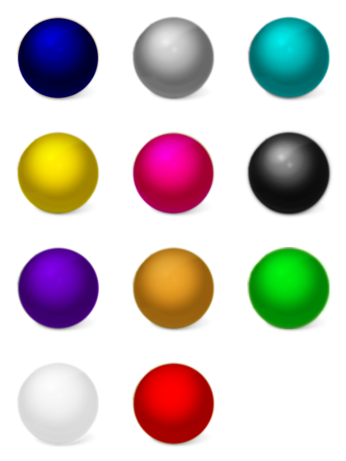
VUV (Decarbonization)
Pellicle-free implant surface
Ti aging (Carbonization)
The Next Gen Implant Dentistry with VUV
Tak Ogawa

Slide 13
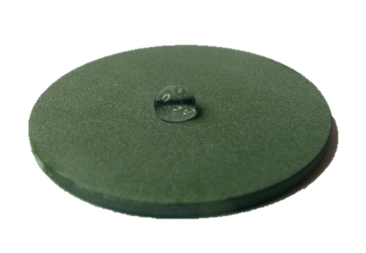
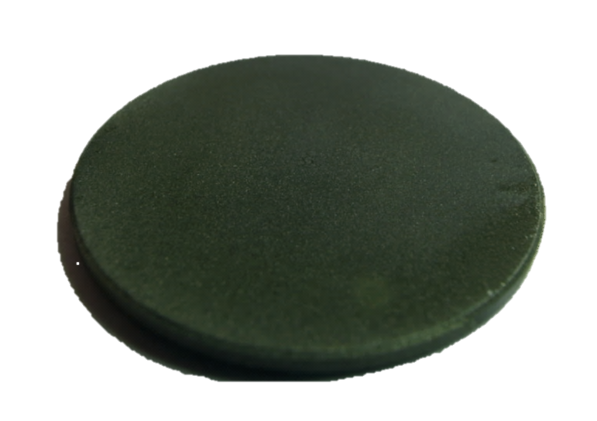
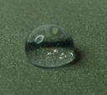
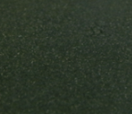
UV treatment restores bio-compromised titanium.
2. Hydrophilicity simply follows the pellicle removal.
Before
After
Hydrophobic
Hydrophilic

Slide 14
UV treatment restores bio-compromised titanium.
UV treatment of titanium accomplishes:
Near perfect bone-implant contact of 98.2%.
3-times faster osseointegration in early healing stage.
5-time greater protein adsorption to implant surface.
50 μm
Control implant
3- to 4-time greater number of osteogenic cells attached to implant surface at the initial stage.
UV treatment fully restores the compromised implants and even make them greater than the original new. This regeneration process is called UV-photofunctionalization or UV activation.
UV-treated implant

Slide 15
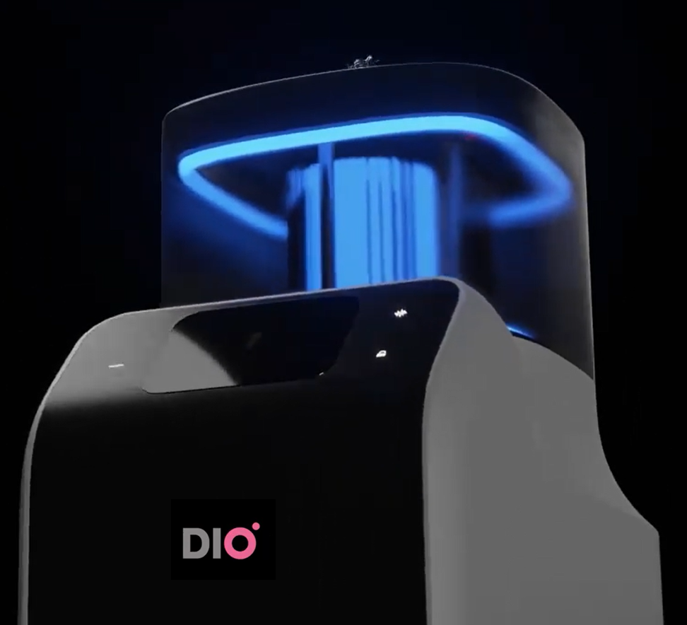
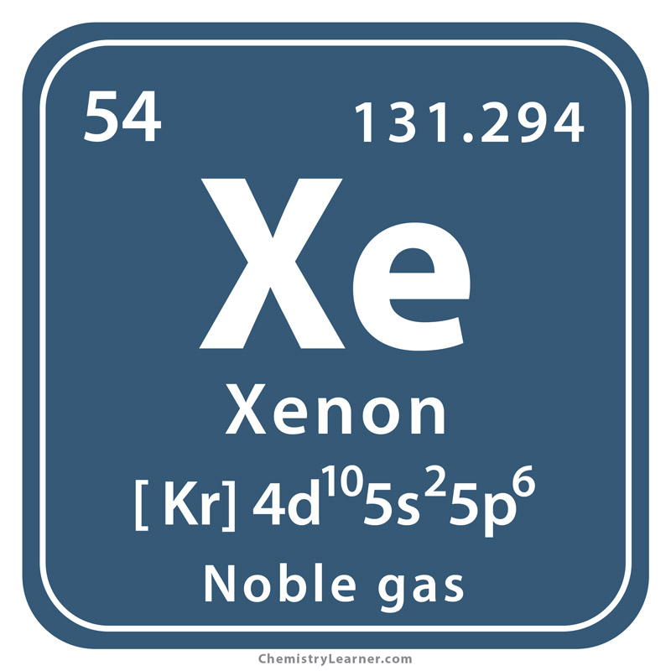
VUV technology makes photofunctionalization to happen in 1 minute.
172 nm wavelength
Xenon excimer vacuum UV (VUV)
DIO Implant and UCLA have co-developed the next-generation UV technology called VUV-powered activation. By exploiting a cutting-edge vacuum, UV (VUV) light with a 172 nm wavelength combined with an innovative synthetic quartz technology — dental implants can now be activated in just one minute, without unpacking the implant.
Tak Ogawa

Slide 16
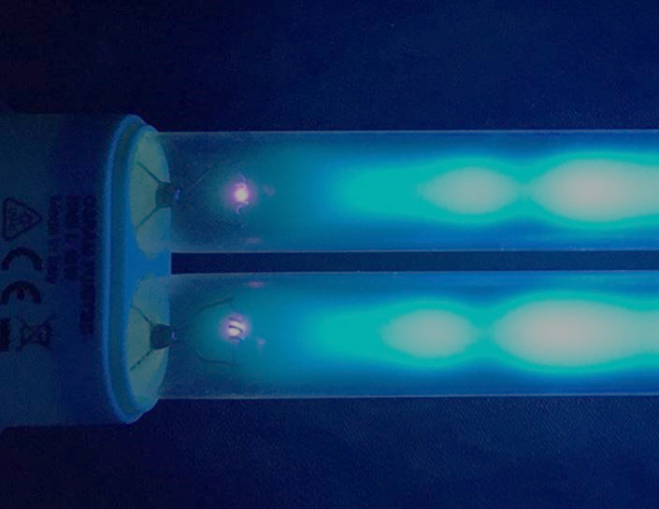
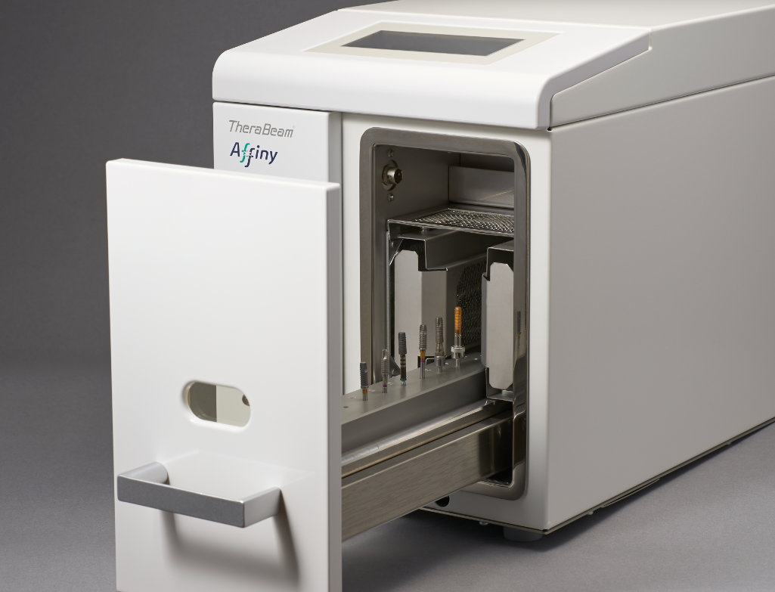
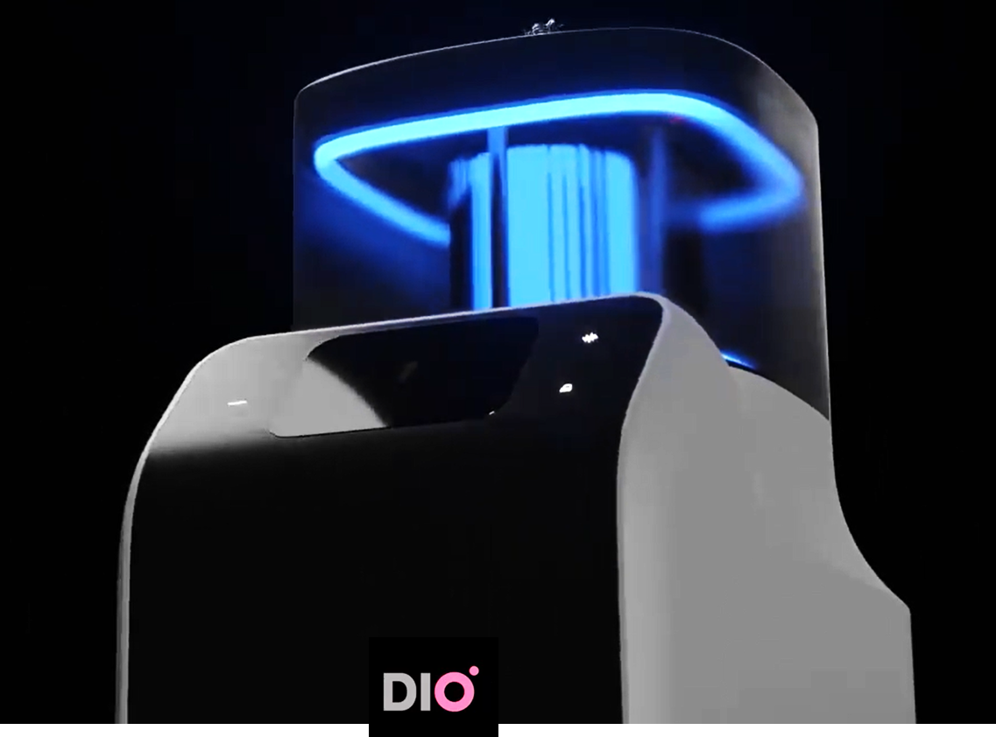
VUV technology makes photofunctionalization to happen in 1 minute.
Decarbonizing
capability
UVC
HUVC
PUV
VUV
VUV overwhelms other UV light sources and devices in decarbonizing capability.
The results of 1-minute decomposing of methylene blue (C₁₆H₁₈ClN₃S) are shown.

Slide 17
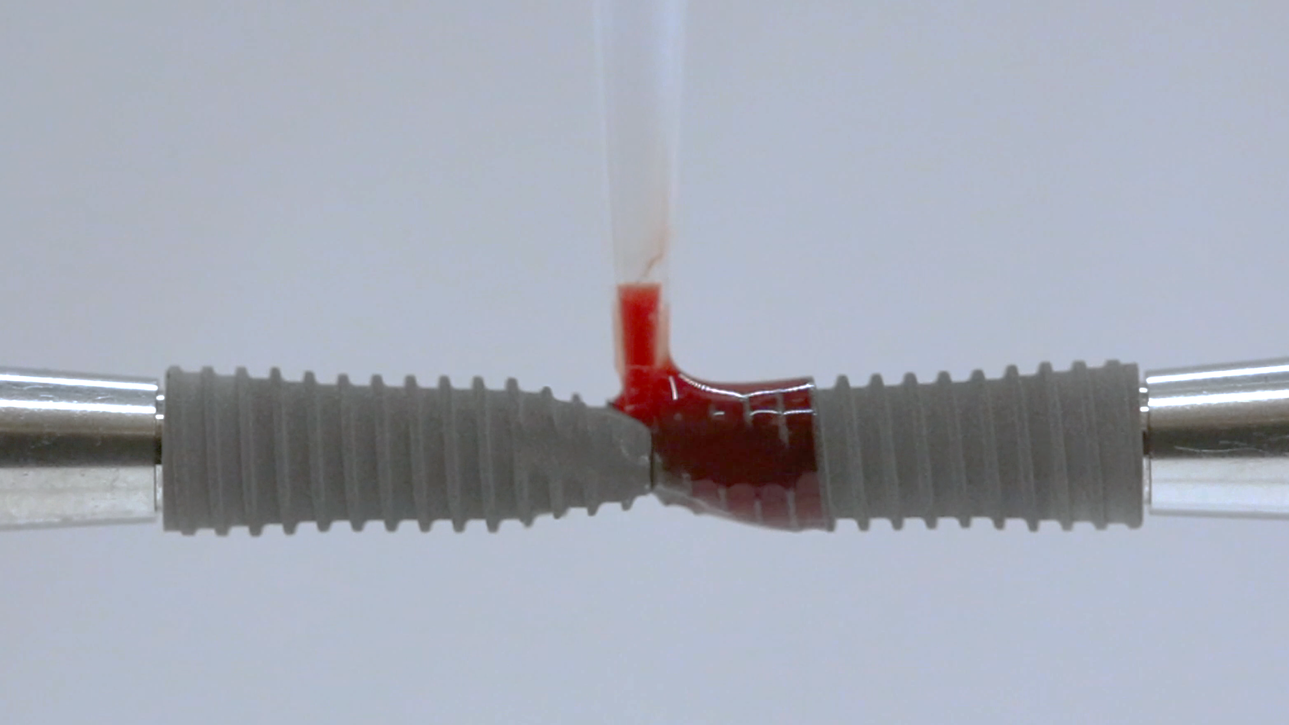
The Dawn of a New Norm
The next generation implant dentistry
with VUV technology
Bio-compromised,
pellicled implant
VUV-activated, pellicle-free implant
Blood and cells can see the pellicle and react accordingly.
It is only natural we get rid of the pellicle.
Perfection finally surfaced.

